Slide 1
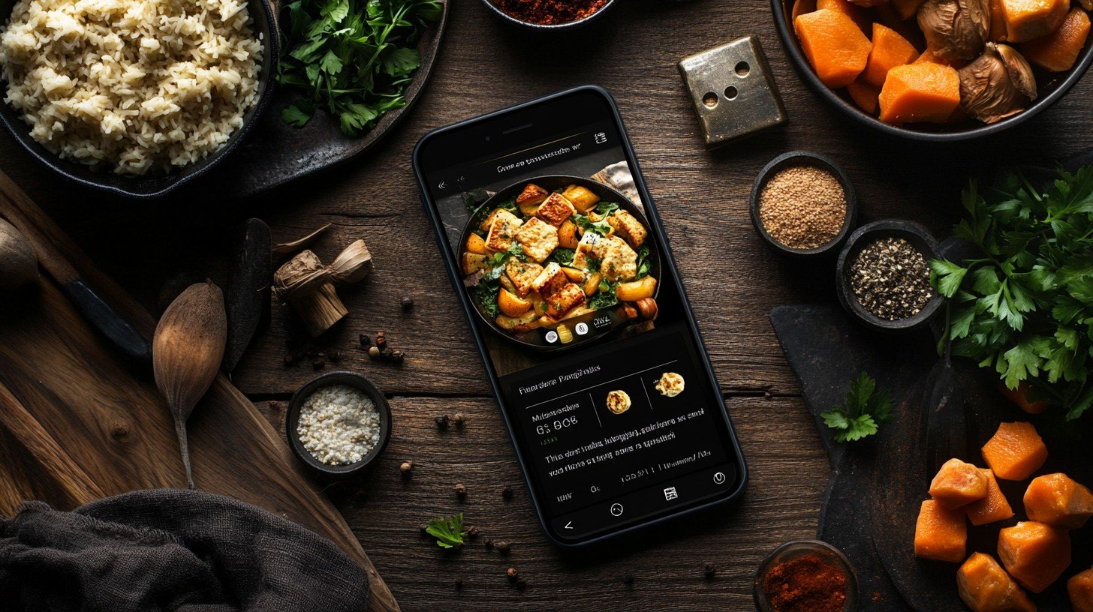
Pantry Pal
Smart Recipe Companion App
Haoran Zhang
Songhan Min
Saiwang Xiang

Slide 2
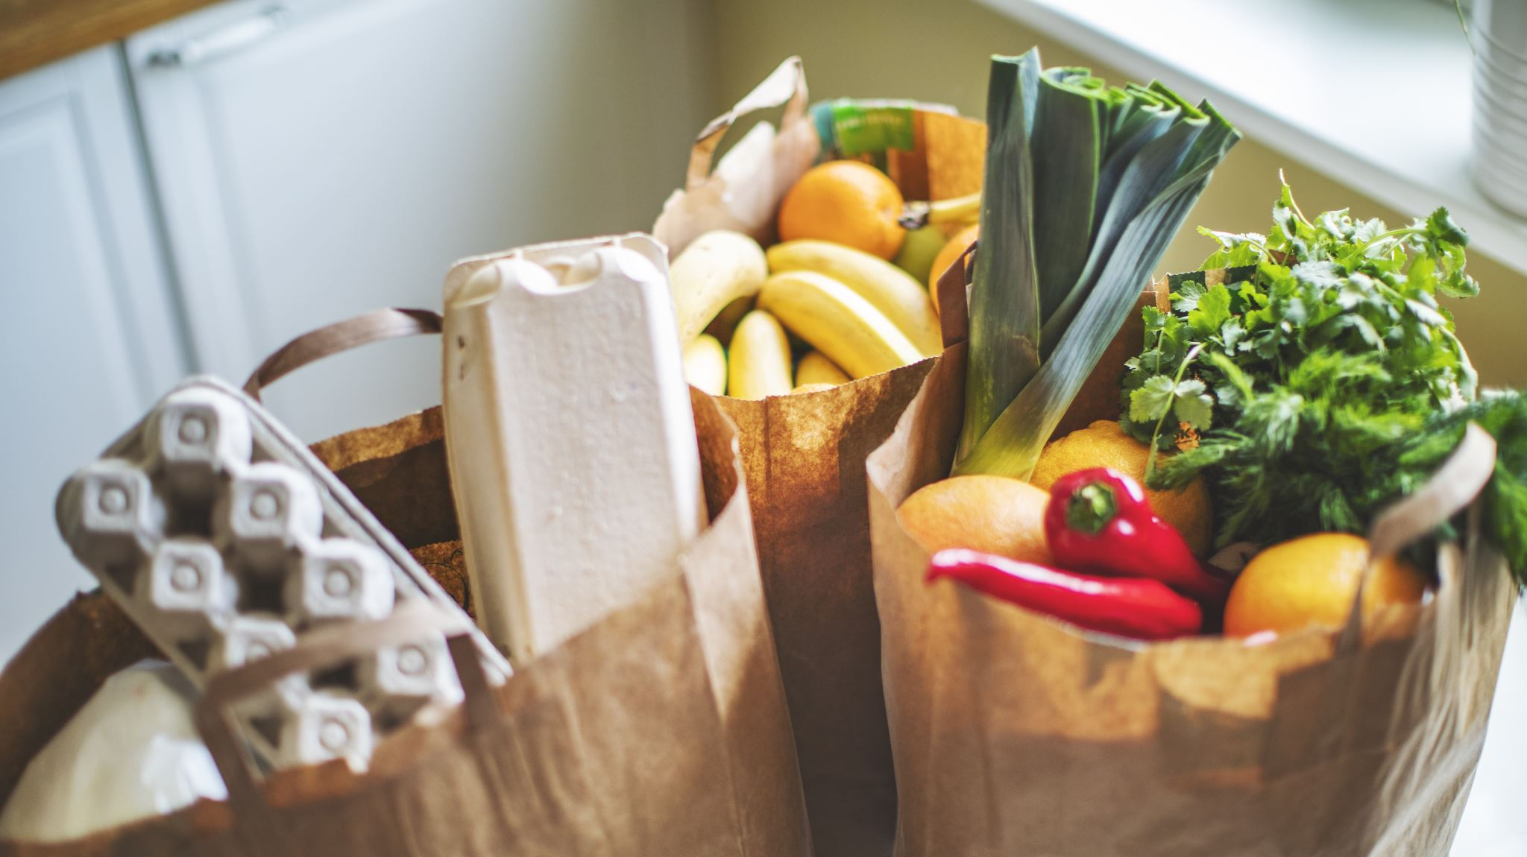
Project Overview
Pantry Pal is a user-centric recipe discovery app designed to minimize food waste and simplify meal planning by leveraging ingredients users already have. Targeting cooking enthusiasts and beginners alike, the app combines practicality with playful interaction, empowering users to cook creatively while reducing unnecessary grocery purchases.
Notes:
"Pantry Pal is designed with the goal of reducing food waste and making meal planning simpler. Imagine coming home, opening your fridge, and instantly knowing exactly what delicious meal you can create with what’s already inside. Whether you're a seasoned cook or just starting, Pantry Pal aims to turn meal prep into an enjoyable, creative process, minimizing unnecessary grocery shopping and helping you manage your pantry effectively."

Slide 3
Targets and Users
Target Users:
Cook beginner and enthusiasts who wants to learn cooking or new dishs
Environmentalists who want to reduce food waste
Project Goal:
Provides personalized recipe recommendations using available ingredients
Enhances fun and interactivity through the "shake-shake" function
Provides convenient recipe storage and offline access
Helps users manage kitchen inventory and shopping lists to improve meal planning efficiency
Notes:
"Our target users range from cooking enthusiasts who enjoy experimenting with new recipes, to busy individuals or beginners looking for quick, practical meal suggestions. Pantry Pal caters specifically to those who want to save time, money, and reduce waste by utilizing ingredients they already own, transforming everyday cooking into an exciting and stress-free experience."

Slide 4
Core Features
1
2
3
4
5
6
Ingredient-Based Recipe Search Users can input or select ingredients (e.g., "chicken, tomato") to discover tailored recipes, encouraging cooking with what’s on hand rather than purchasing extra groceries.
“Shake for Surprise” (Fun Sensor Integration) A playful feature where users shake their phone to receive a random recipe suggestion, powered by the accelerometer, making meal planning interactive and fun.
Personal Cookbook (Local Save) Save favorite recipes locally for offline access, turning Pantry Pal into a convenient digital recipe book available anytime.
Pantry & Grocery Helper Track pantry items within the app and, when viewing recipes, see what’s missing—adding needed ingredients to a grocery list for efficient shopping.
Clean UI & Accessibility A simple, readable interface with proper contrast, dark mode, voice input search, and screen reader support ensures a delightful experience for all users.
Potential Feature: AI recognition to update inventory Call up the device camera and update the food pantry in the app by taking photos of existing ingredients, which the AI then recognizes as text.
Notes:
"Pantry Pal provides several key features to enhance the cooking experience. The primary feature is our ingredient-based search, where users simply input available ingredients to find suitable recipes. We also include a fun and interactive 'Shake to Surprise' function—just shake your device to discover random recipes. Additionally, users can manage their pantry items within the app, tracking what ingredients they have or need, and even generate automatic shopping lists based on selected recipes."

Slide 5
Technical Approach
Database:
A local database stores saved recipes and pantry lists, enabling offline access and quick retrieval for the Personal Cookbook and Pantry & Grocery Helper features.
API：
Integrates with the Edamam Recipe API Edamam Recipe APIto fetch recipes based on user-entered ingredients.
Sensors:
Accelerometer: Detects phone shakes to trigger the "Shake for Surprise" feature.
Microphone: Supports voice input for hands-free recipe or ingredient searches.
Notes:
"To build a robust and user-friendly app, we've chosen modern technologies and best practices. Pantry Pal follows an MVVM architecture to clearly separate UI, business logic, and data management. We're using Jetpack Compose for designing an intuitive and responsive interface, providing smooth navigation and a delightful user experience. Our app employs Room Database for efficient local data storage, allowing users to manage pantry items offline. Furthermore, we seamlessly integrate Edamam recipe API via Retrofit, fetching accurate recipe data in real-time, ensuring users always receive up-to-date meal suggestions."

Slide 6
Testing Strategy
Target Devices:
Pantry Pal is designed for multi-device compatibility, supporting both phones and tablets. The responsive UI adapts seamlessly, offering a compact layout on phones and an expanded dashboard on tablets for an optimal user experience across screen sizes.
Smartphone (Portrait mode, ~6” screen): Primary design for one-hand use.
Tablet (Large screen, ~10”): Optimized multi-pane layout. On tablets, the app will take advantage of the extra space by showing multiple panels at once.
Notes:
"We’ve implemented a comprehensive testing strategy to ensure quality and reliability. Our testing includes unit tests to verify core functionalities like pantry management and recipe fetching. UI tests through Jetpack Compose Testing guarantee smooth interactions and visual consistency. Additionally, extensive manual testing across various devices and screen sizes ensures responsive designs perform flawlessly, making Pantry Pal reliable and enjoyable no matter how it's accessed." "Pantry Pal is carefully optimized for multi-device compatibility, focusing on smartphones and tablets. On smartphones, especially around a 6-inch portrait mode screen, the layout is compact, designed specifically for one-handed use. For tablets with larger screens around 10 inches, Pantry Pal provides a multi-pane interface, effectively utilizing the extra screen real estate to display more information clearly and simultaneously. This responsive design ensures users have an excellent experience, whether they're quickly checking ingredients or leisurely browsing recipes."

Slide 7
Expected Outcomes
Reduced Food Waste:
Users utilize pantry staples efficiently, cutting unnecessary purchases.
Enhanced User Experience:
Engaging features (e.g., shake-to-discover) and intuitive design drive retention.
Notes:
"We anticipate Pantry Pal will significantly improve user convenience in meal planning, effectively reduce food waste, and enhance overall cooking satisfaction. By helping users creatively utilize their existing ingredients, we believe the app will positively impact both their lifestyle and the environment, promoting more mindful consumption habits."

Slide 8
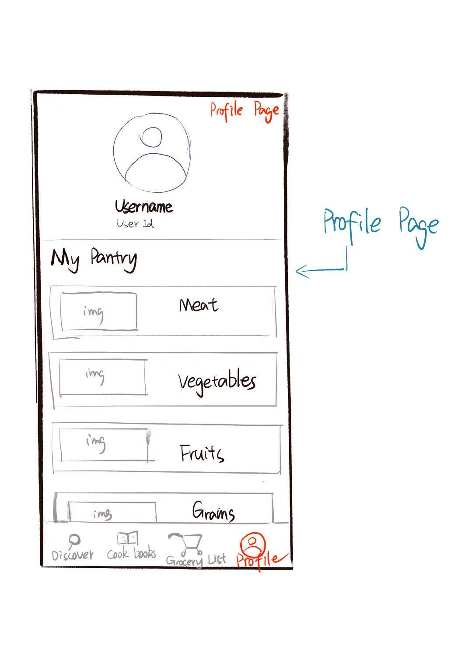
Sketches
Notes:
"Here are some preliminary sketches illustrating the planned user interface. The sketches demonstrate our emphasis on user-friendly design, clear visual organization, and intuitive navigation, ensuring that users can quickly find recipes, manage pantry items, and explore meal options with ease.""Let’s start with the Profile Page. At the top, users can see their profile icon, username, and user ID.Below that, there's the ‘My Pantry’ section, where food items are grouped into categories. Each section can display images and contents of what the user currently has. At the bottom, we have a fixed navigation bar with four tabs: Discover, Cook Books, Grocery List, and Profile."

Slide 9
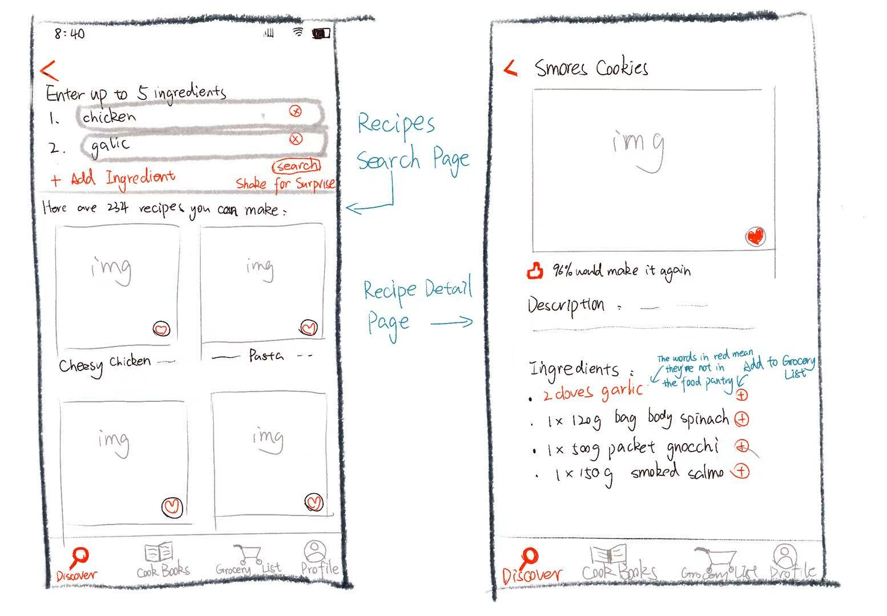
Notes:
"Next, we have the Discover section" Users can enter up to 5 ingredients they have, and the app will suggest recipes they can make.They can also use the 'Shake for Surprise' button for a fun random suggestion.Each recipe is shown as a card with an image, title, and a favorite button. Clicking this button can add this recipe to ‘my cookbook’"
"Clicking a recipe takes the user to the detail page. It shows an image and a description.The ingredient list is shown below, and any missing ingredients are highlighted in red.Users can easily tap to add missing items directly to their Grocery List."

Slide 10
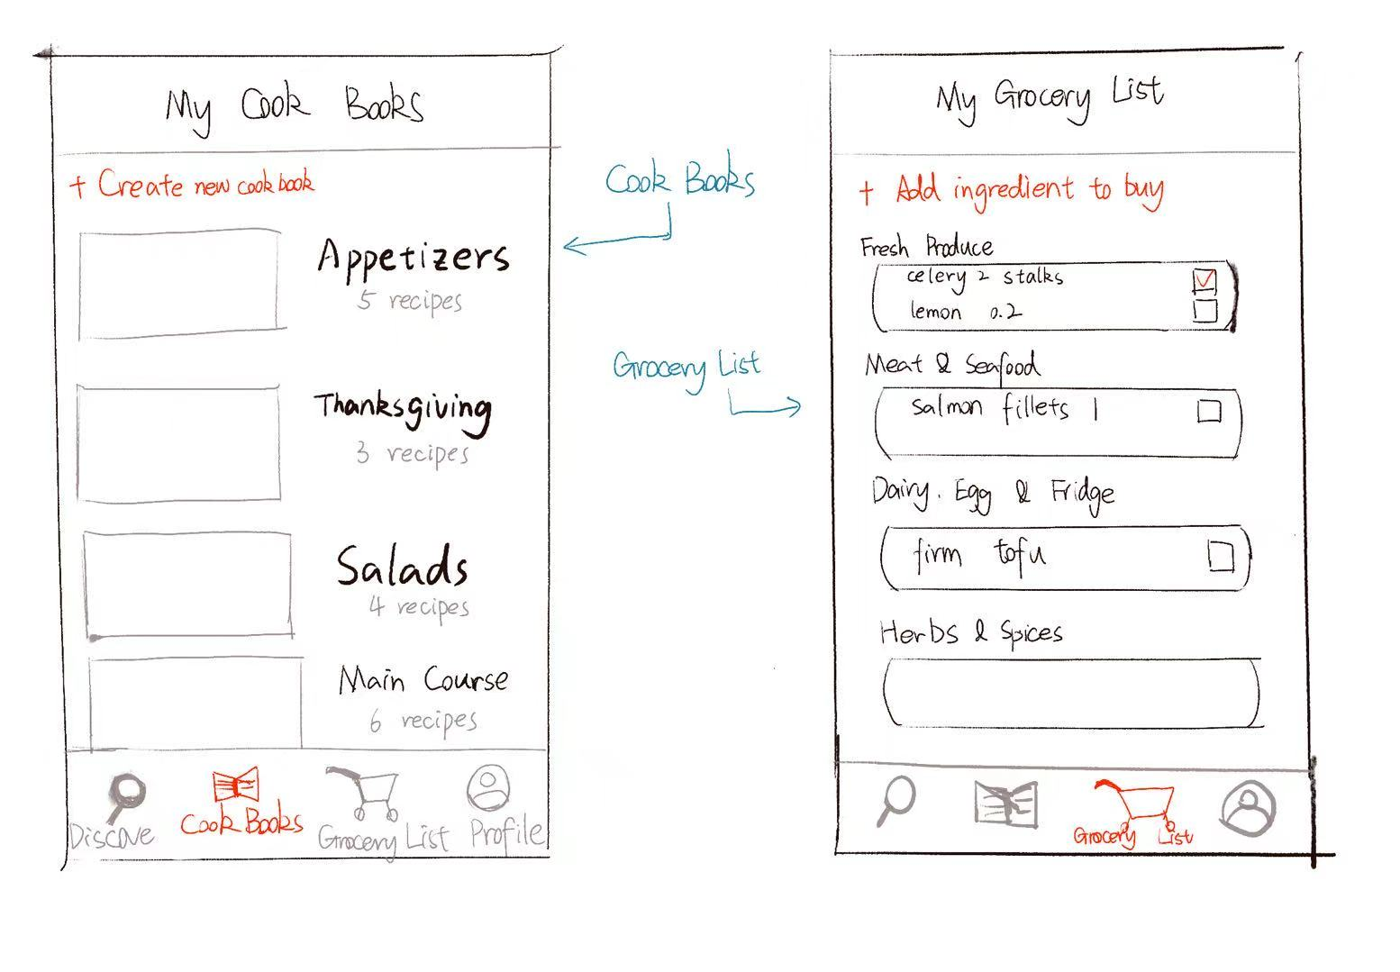
Notes:
"The next section is the Cook Books page. Here, users can organize their favorite recipes into personalized cookbooks. Users can also create new cookbooks by tapping the '+ Create new cookbook' button.This makes it easy to organize meals for different occasions.
"Finally, we have the Grocery List section. This is where users can keep track of ingredients they need to buy. Items are grouped into categories. Each item can be checked off once purchased.Users can also manually add new items with the '+ Add ingredient to buy' button at the top.

Slide 11
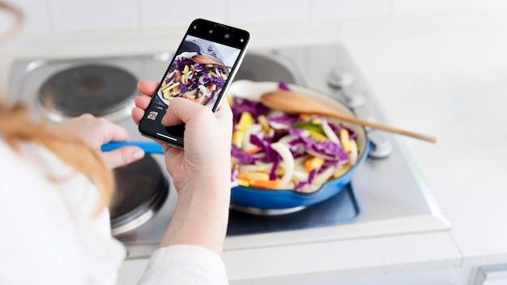
Conclusion
Notes:
"In conclusion, Pantry Pal integrates practical cooking solutions with modern technology, creating a user-friendly experience aimed at enhancing everyday life. Thank you very much for your attention. We’re happy to answer any questions you may have."

